Slide 1
GROW
GAL JAKIČ
PARACOACHING XCELLERATOR SESSIONS 13. - 14.9.2021

Slide 2
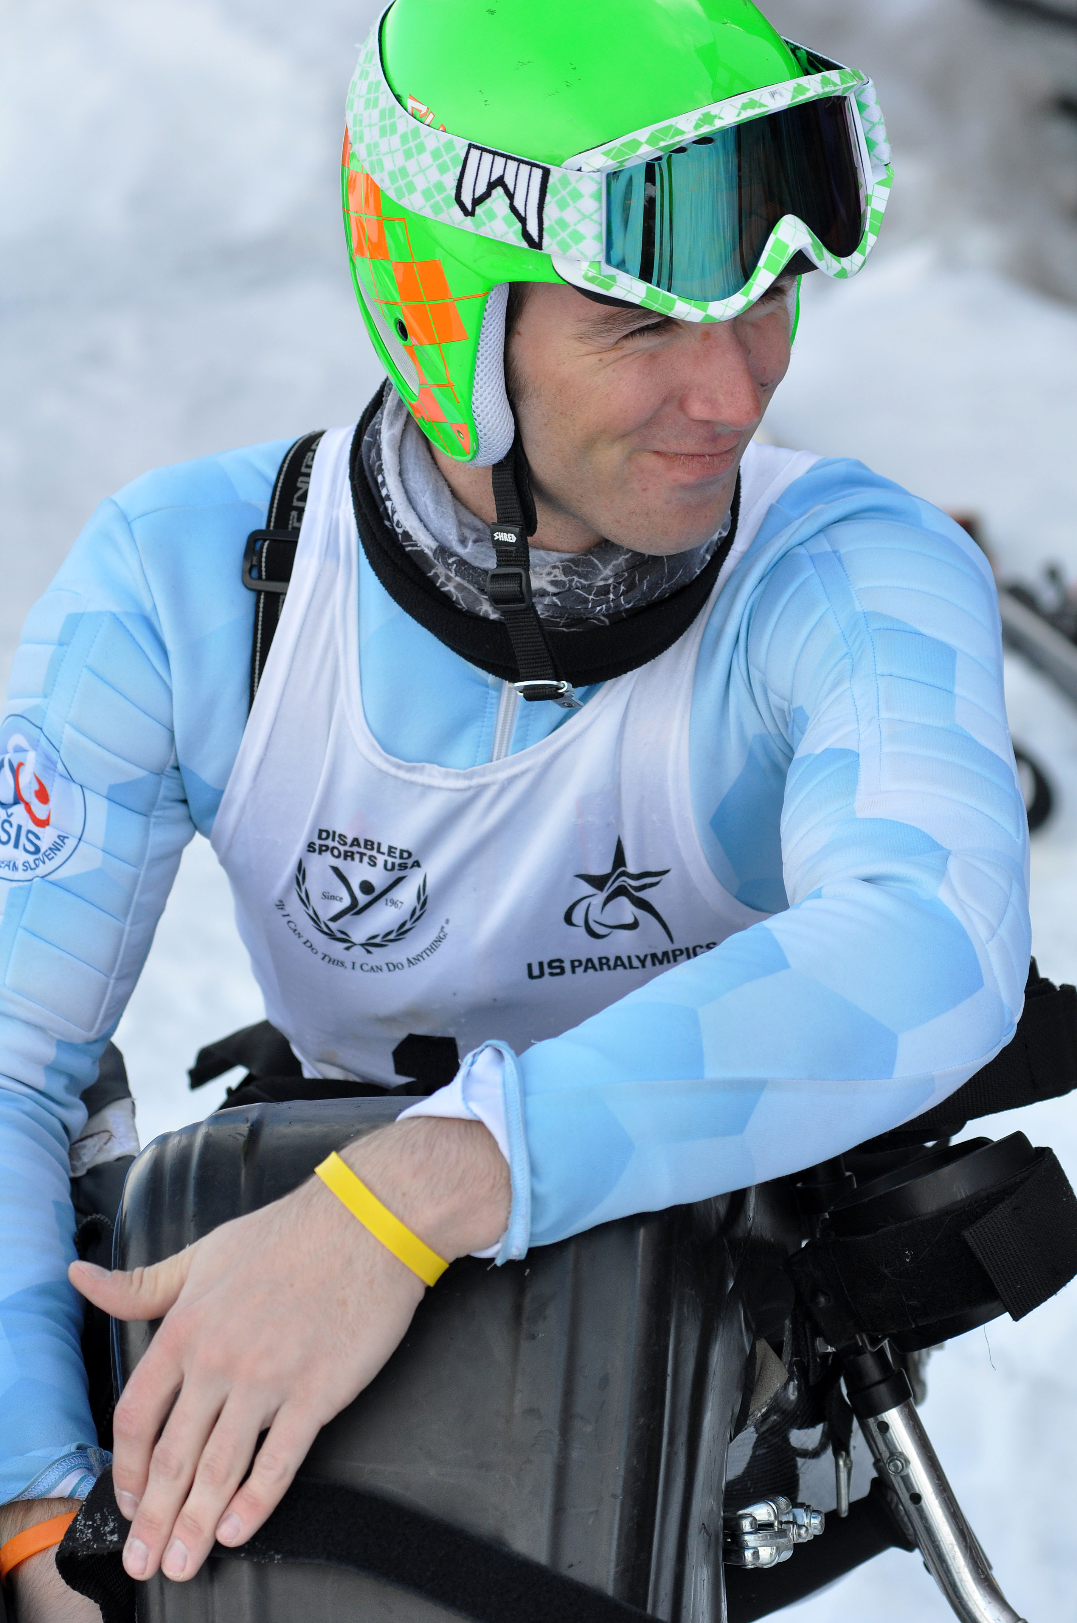
ABOUT ME
A.K.A. WHY SHOULD YOU CARE
3x WINTER PARALYMPIAN NPC SLOVENIA EMPLOYEE ANTI-DOPING & YAMBA AMBASSADOR STARTUP GUY
GAL JAKIČ - PARACOACHING XCELLERATOR SESSIONS, 13. - 14.9.2021

Slide 3
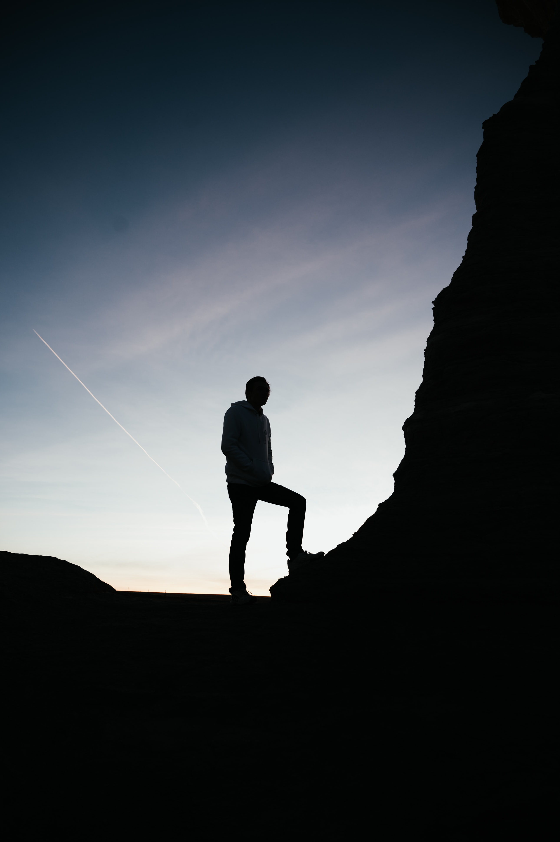
WHAT IS E-LEARNING?
OR RATHER WHAT IT ISN’T

Slide 4
E-LEARNING IS NOT PUTTING CLASSROOM VIDEOS ON THE WEB

Slide 5
E-LEARNING IS NOT MAKING PRETTY PDFs AND EMAILING THEM

Slide 6
E-LEARNING IS NOT ABOUT CHOOSING THE MOST EXPENSIVE LMS

Slide 7
E-LEARNING IS NOT ABOUT CHOOSING A GOOD LOGO AND DOMAIN

Slide 8
E-LEARNING IS DIFFERENT EVERY TIME
DEPENDING ON THE ORGANIZATION IMPLEMENTING IT

Slide 9
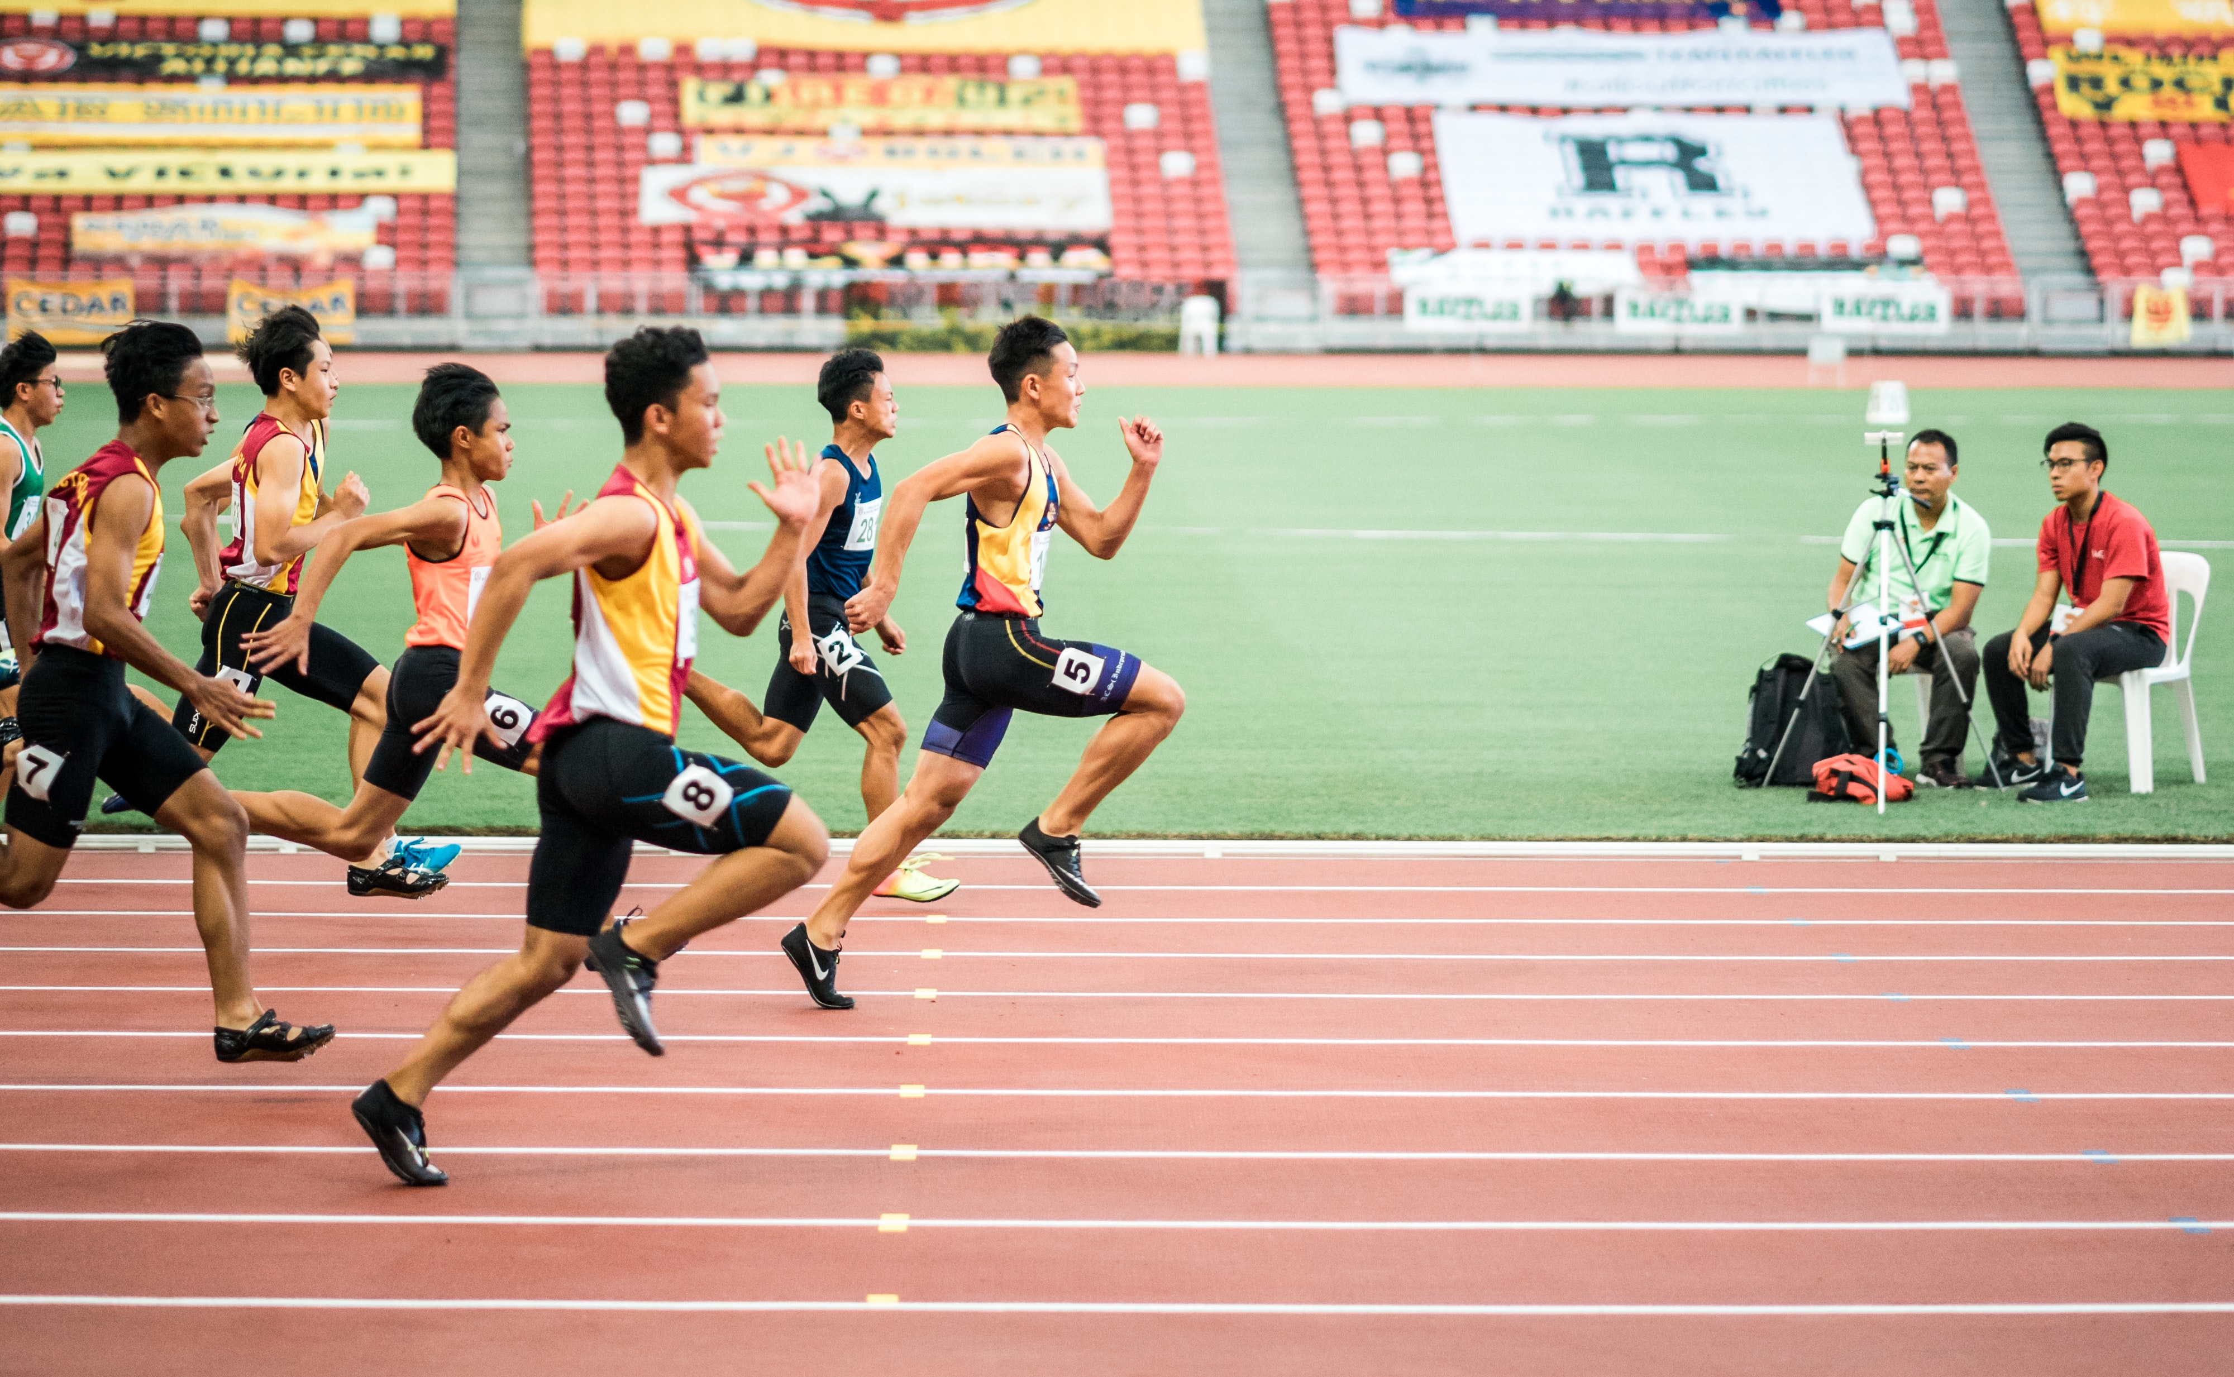
YOUR SPORT FOR LIFE
EAAF - EUROPEAN ATHLETICS FEDERATION

Slide 10
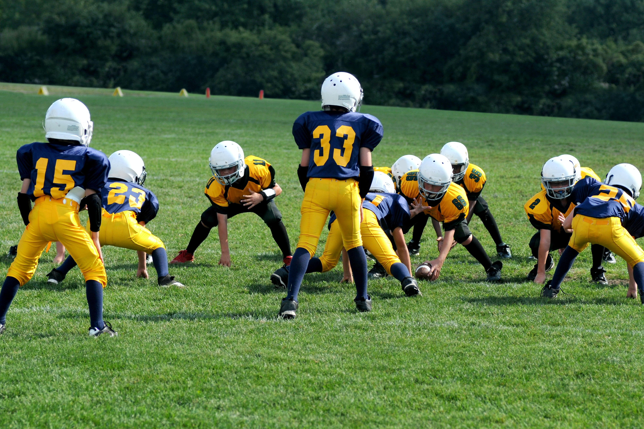
GIVE PARENTS THE TOOLS
USA FOOTBALL

Slide 11
GROW 101
FROM THEORY TO PRACTICE

Slide 12
GOALS RESOURCES OUTCOMES WHy?

Slide 13
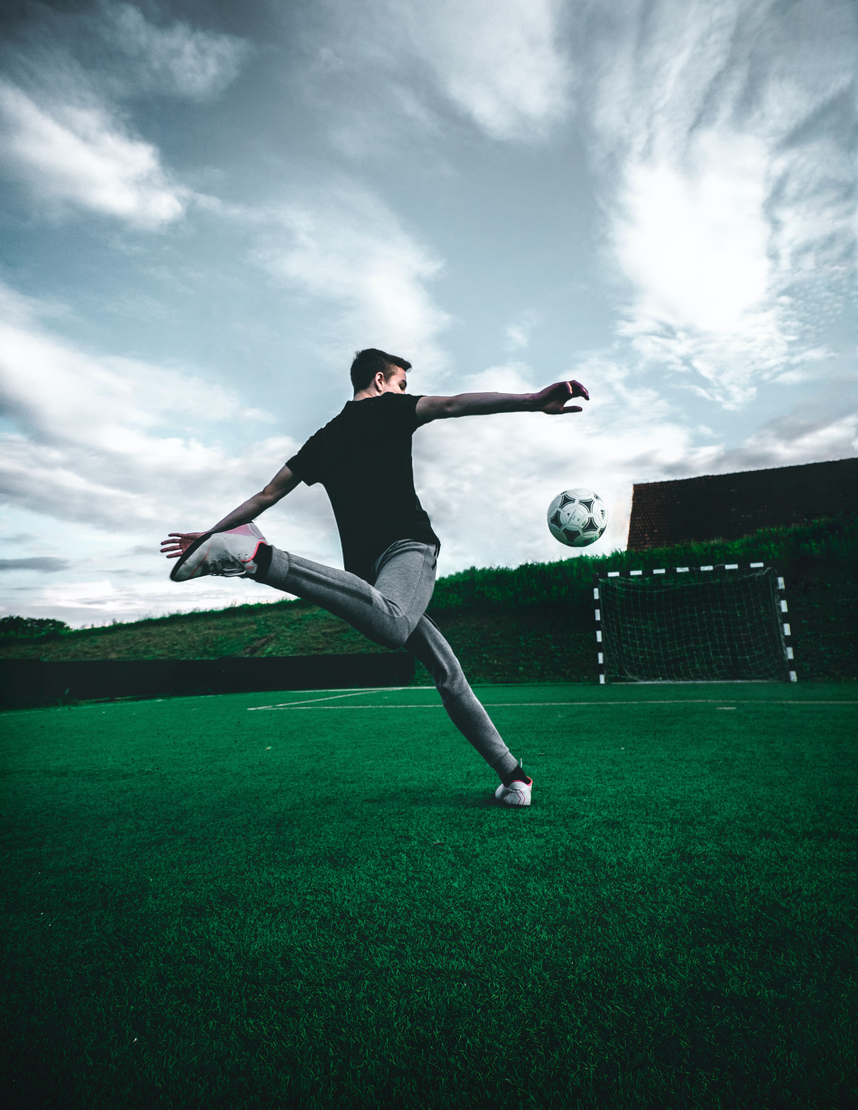
GOALS
ARE WE GOING TO GET MORE COACHES INVOLVED? ARE WE TRYING TO GROW AWARENESS OF THE SPORT? DO WE ALREADY HAVE PEOPLE INTERESTED, BUT WITHOUT ACCESS TO TOOLS & RESOURCES?
GAL JAKIČ - PARACOACHING XCELLERATOR SESSIONS, 13. - 14.9.2021

Slide 14
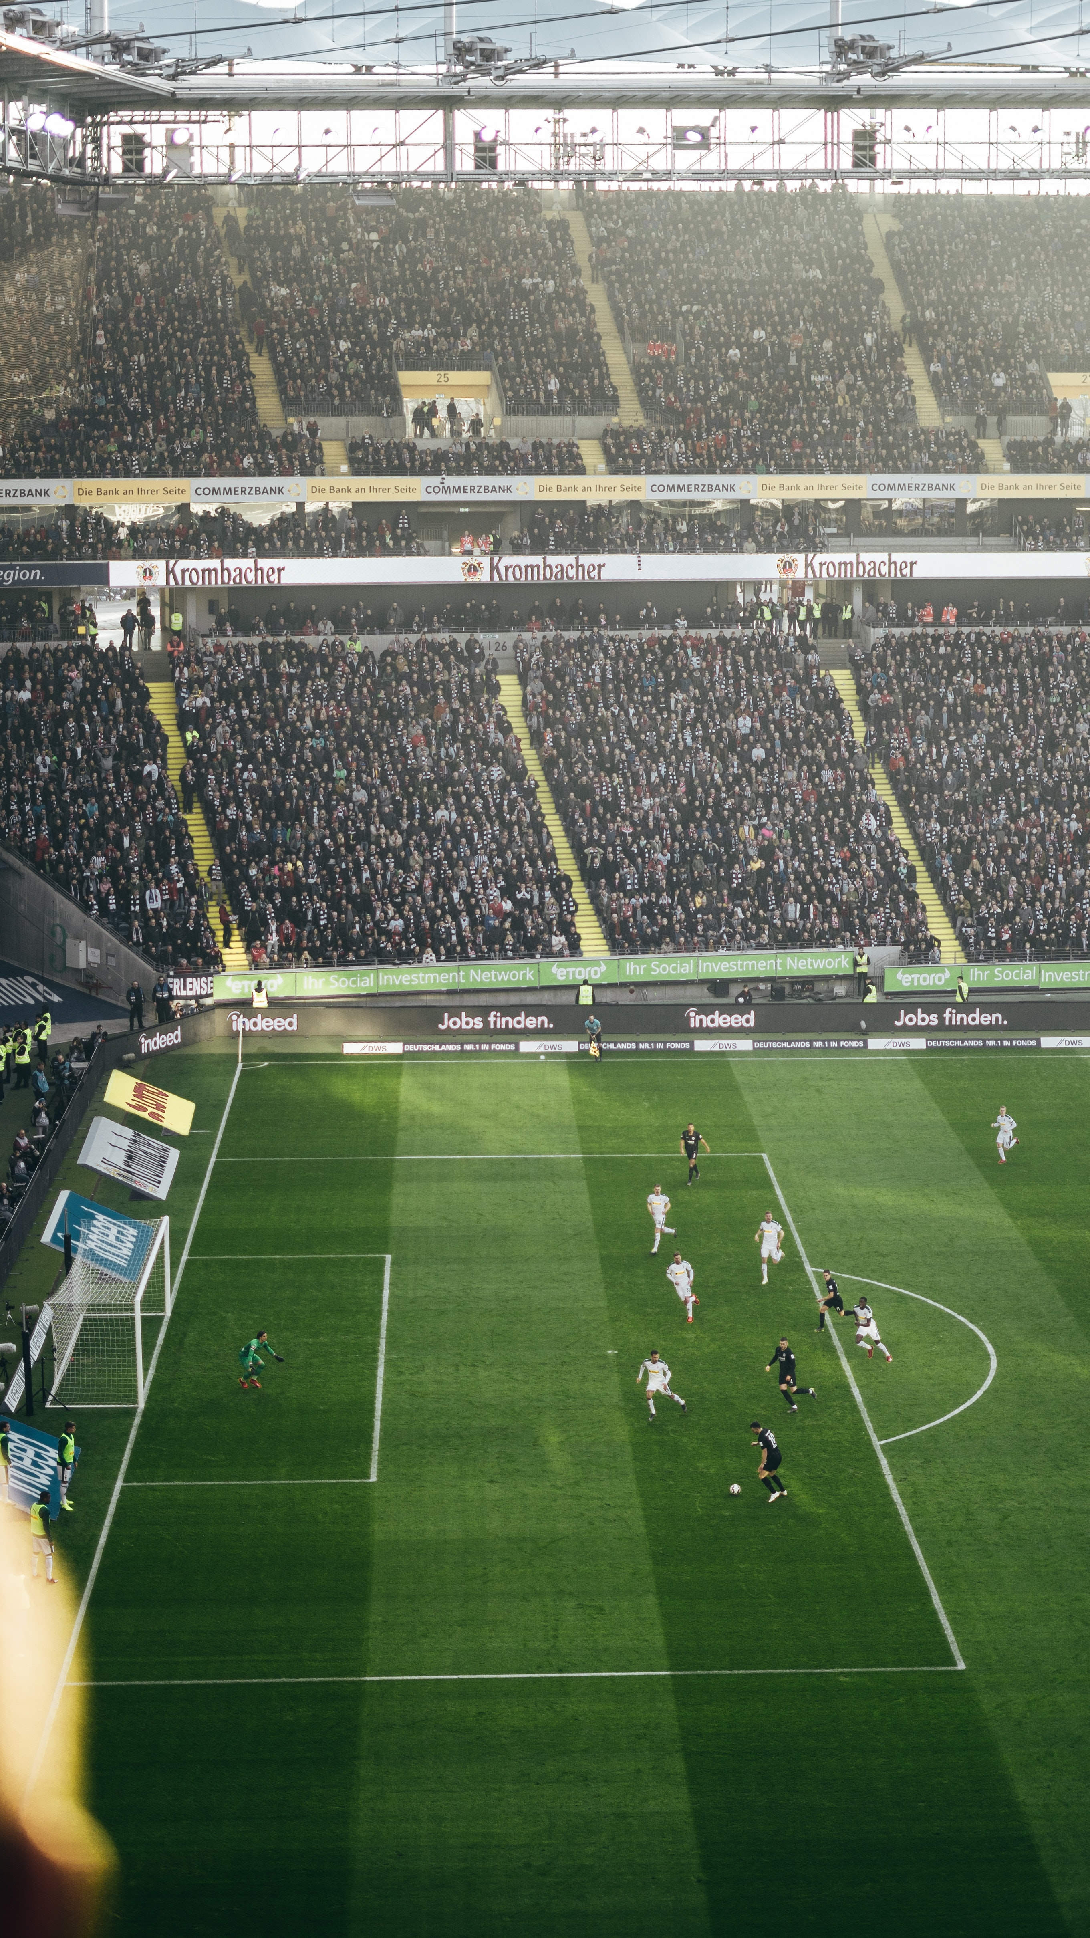
RESOURCES
HOW MUCH MONEY WE HAVE? HOW MUCH TIME WE HAVE? HOW MANY PEOPLE WILL BE INVOLVED? WHAT IS OUR AUDIENCE SIZE AND WHERE IS IT?
GAL JAKIČ - PARACOACHING XCELLERATOR SESSIONS, 13. - 14.9.2021

Slide 15
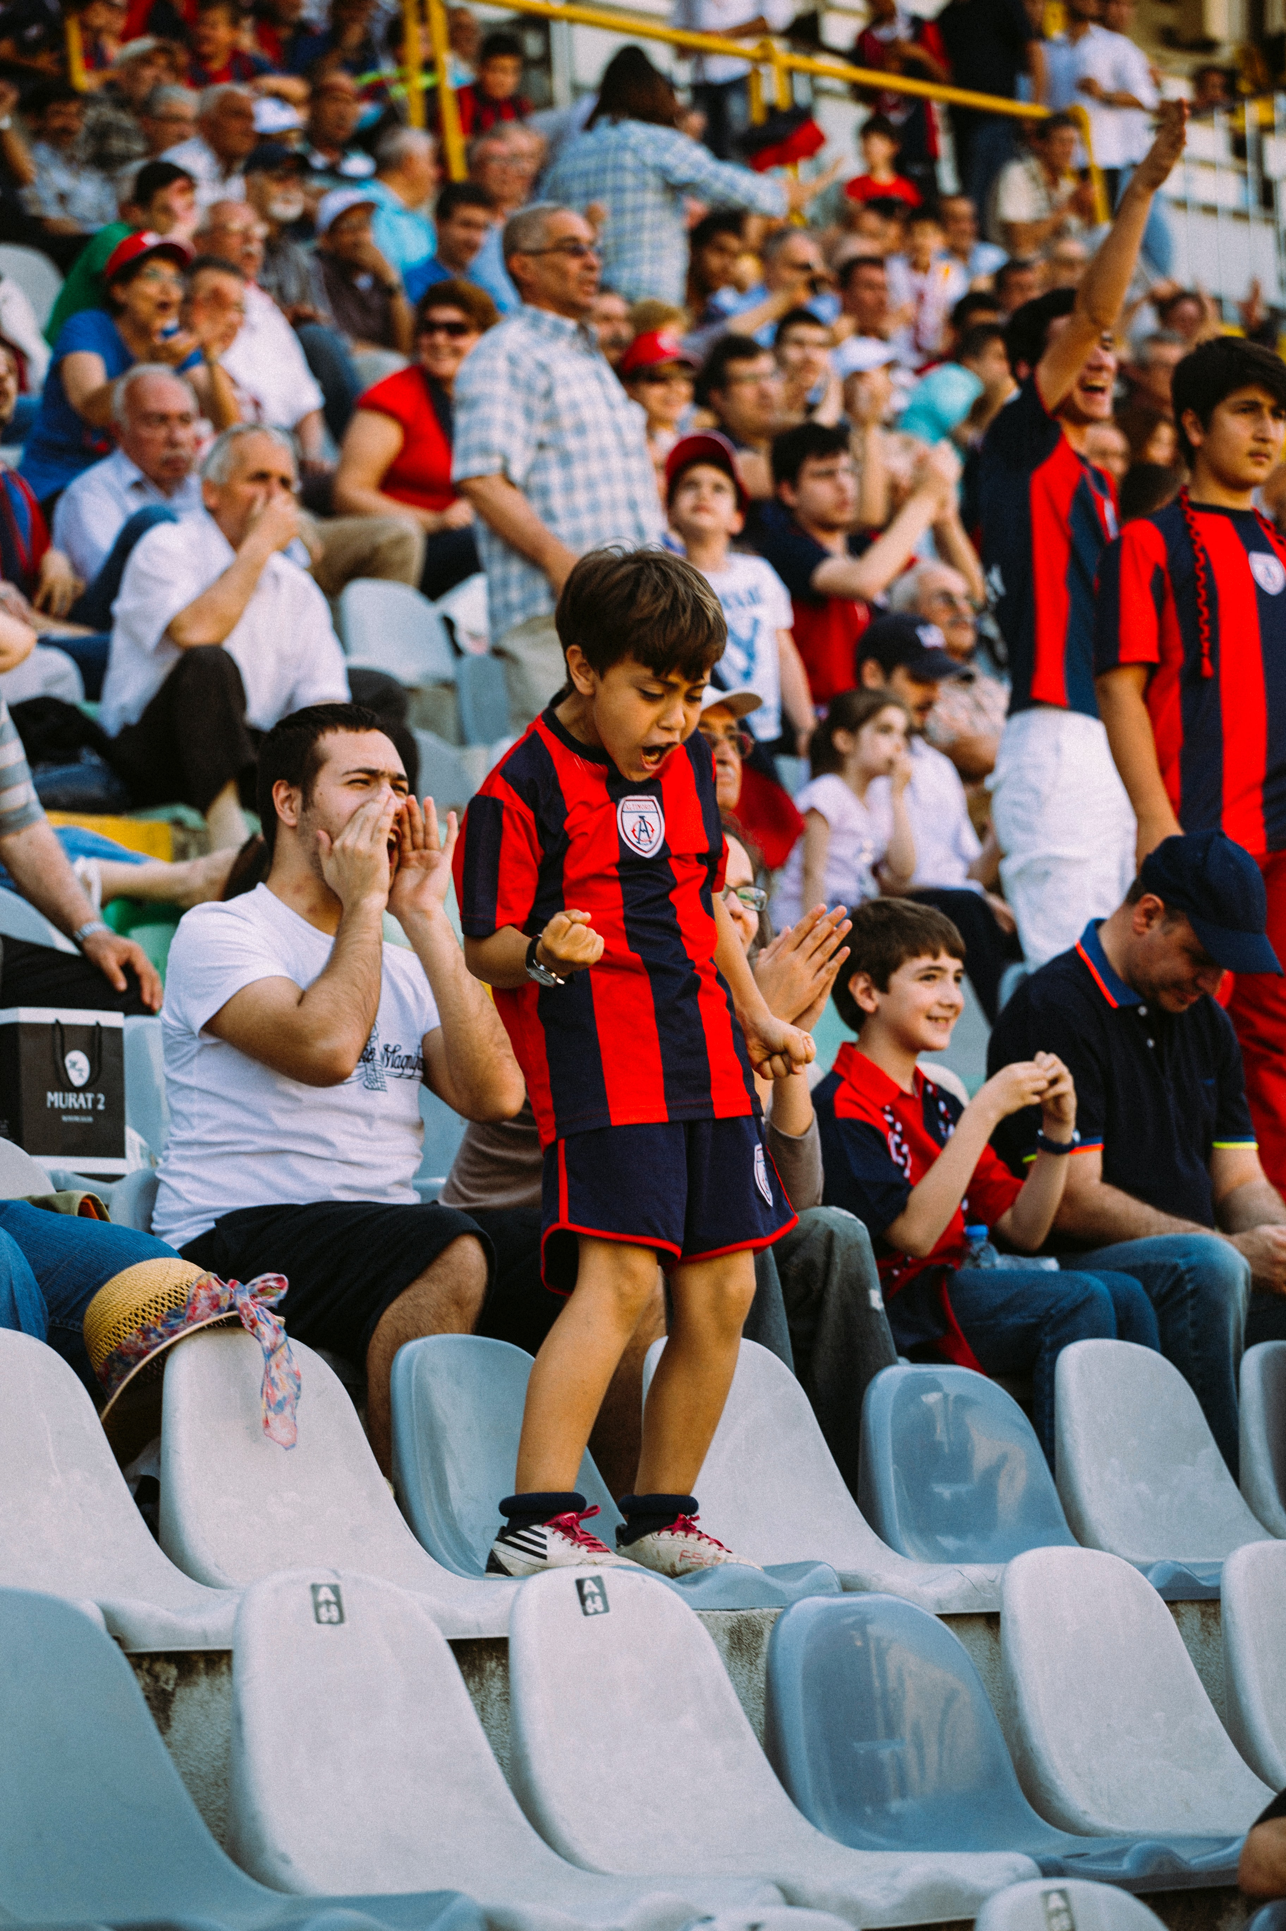
OUTCOMES
HOW MANY STUDENTS WE GOT? WHERE DID THEY FIND US? WHAT TO SPEND MORE MONEY/TIME ON? WHICH EFFORTS WERE A WASTE OF MONEY/TIME?
GAL JAKIČ - PARACOACHING XCELLERATOR SESSIONS, 13. - 14.9.2021

Slide 16
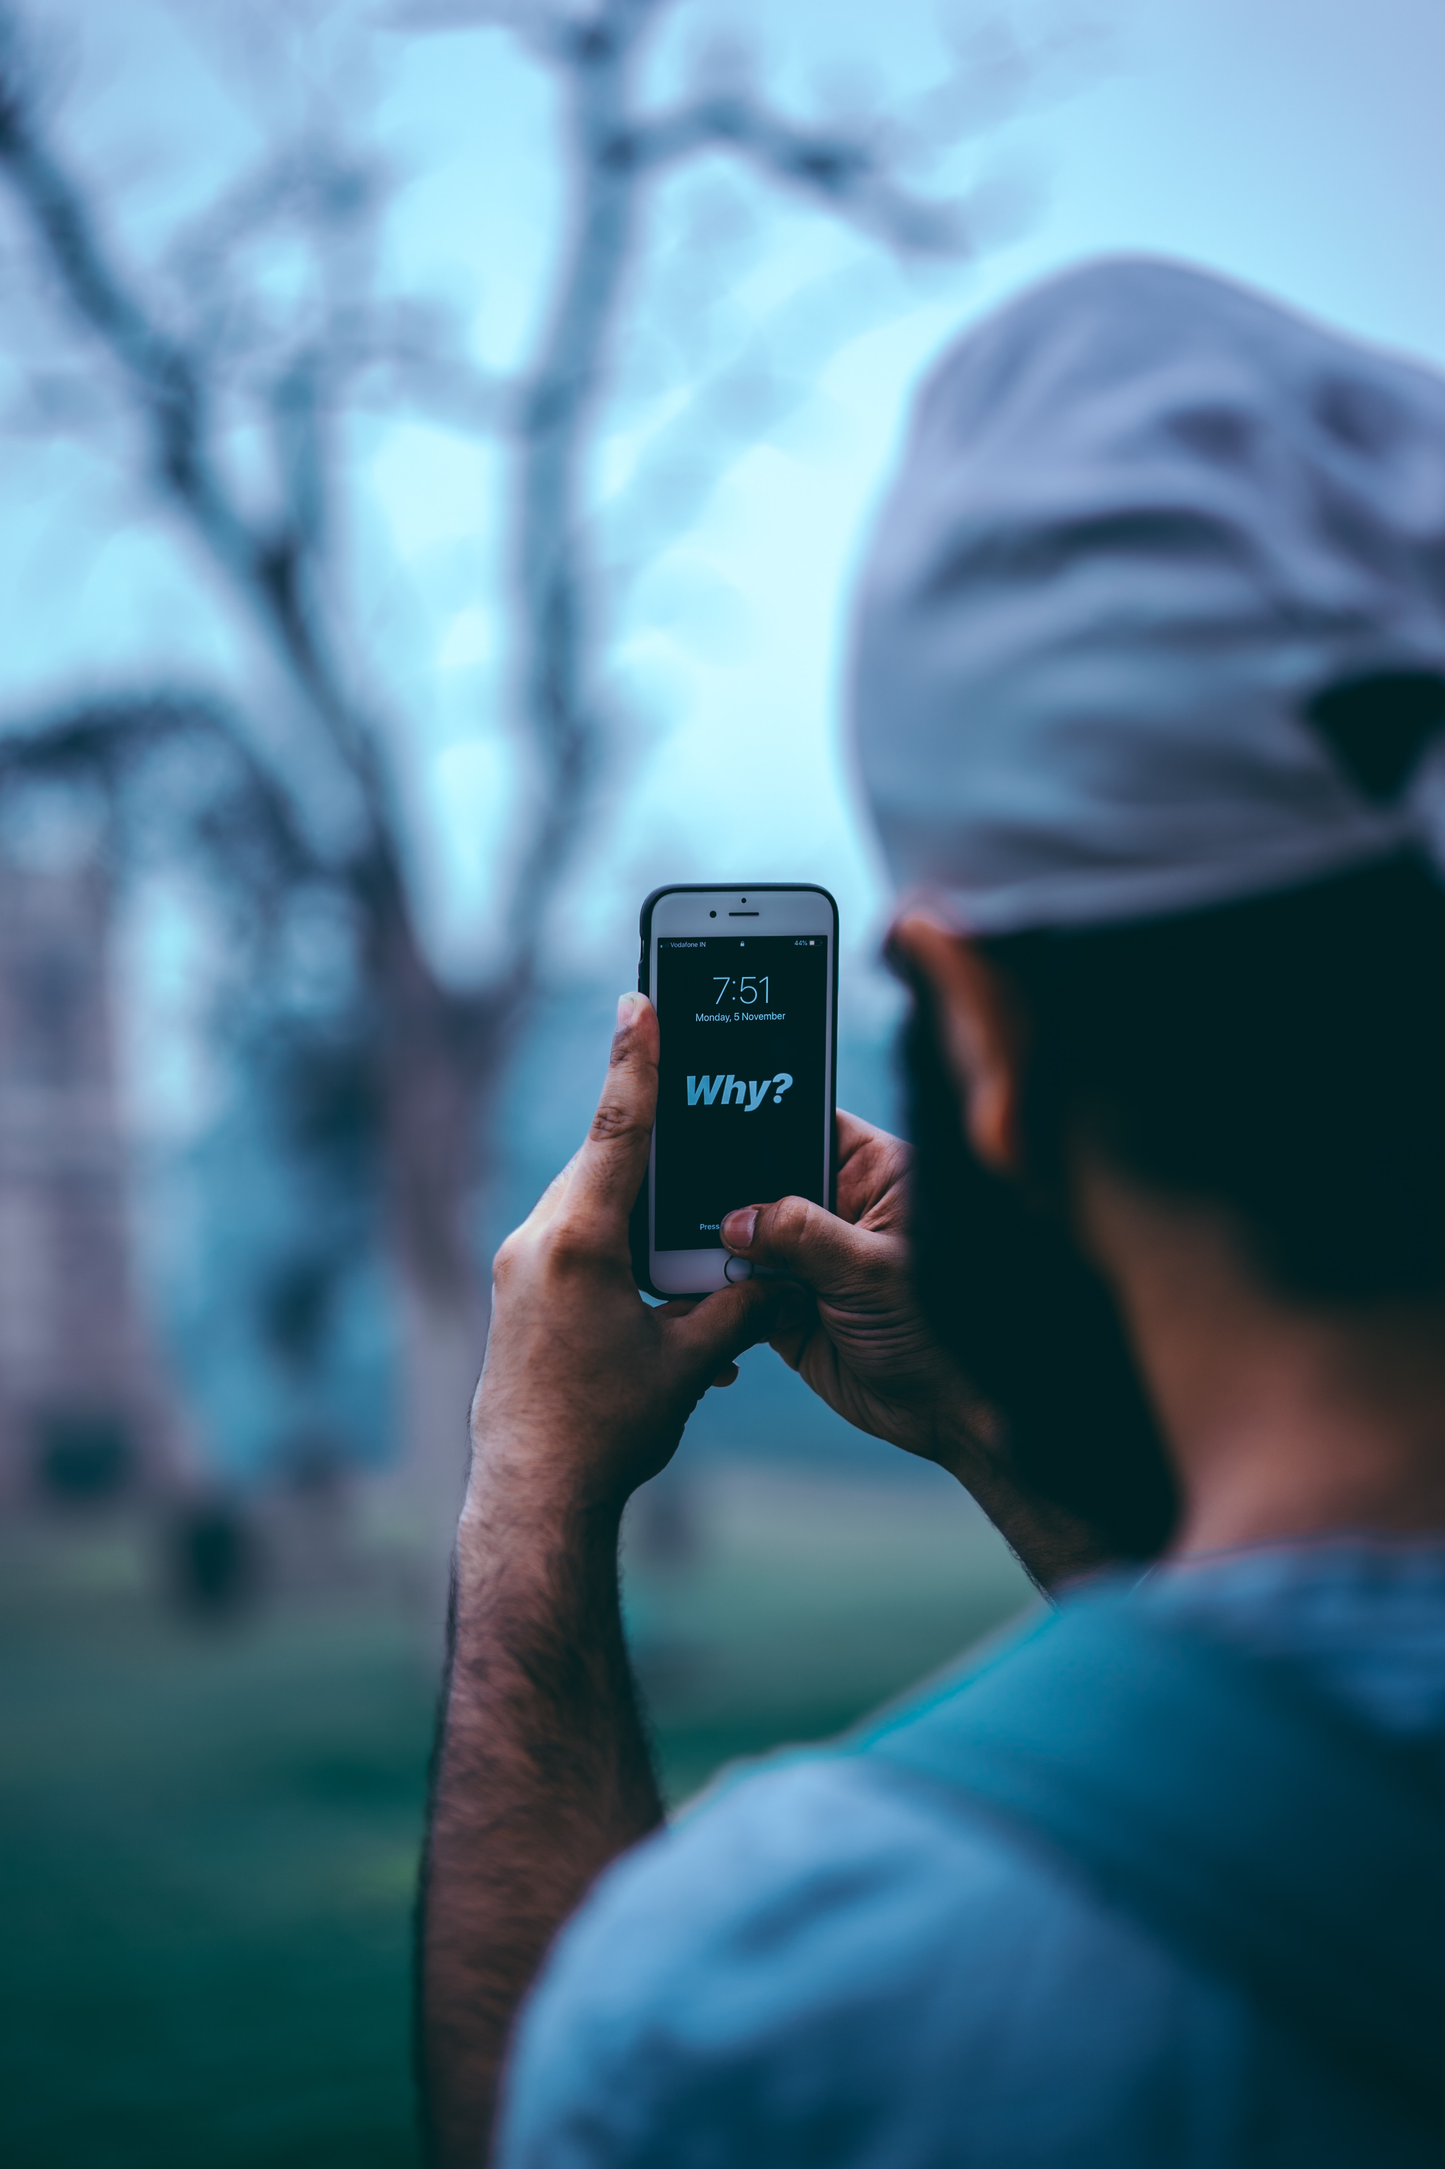
WHY?
GAL JAKIČ - PARACOACHING XCELLERATOR SESSIONS, 13. - 14.9.2021

Slide 17
ASKING WHY WILL ALLOW YOU TO SEE AND TO ACT

Slide 18
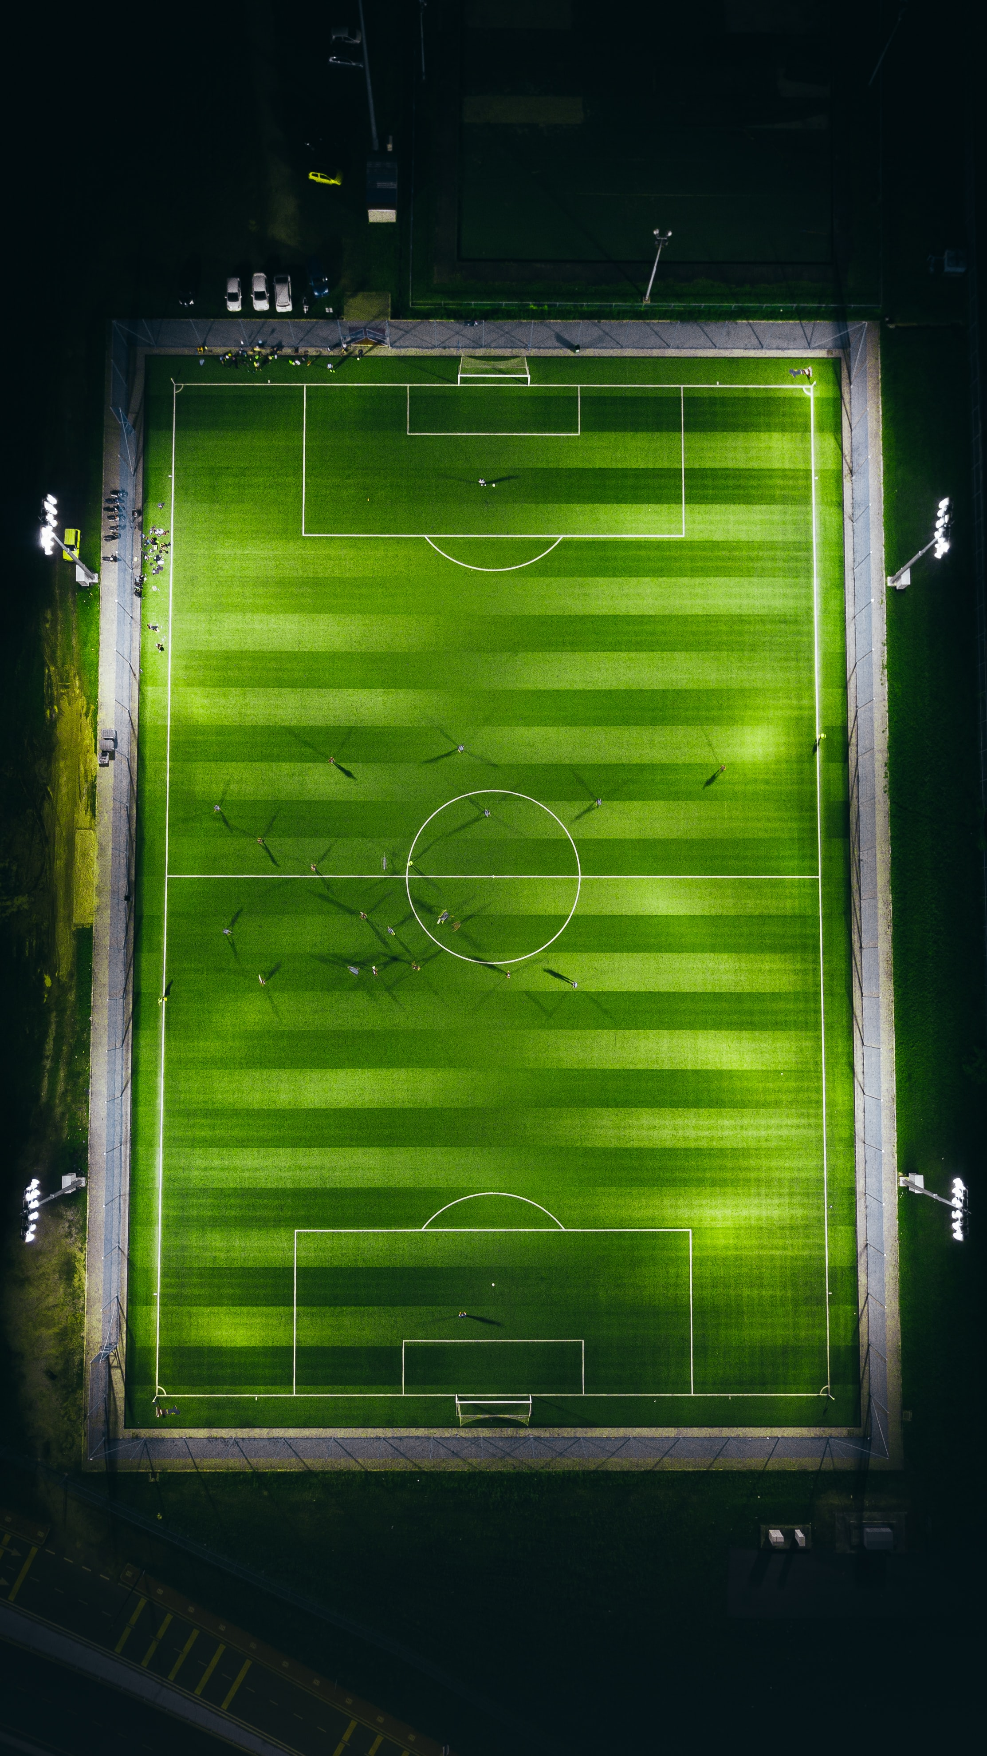
GROW 102
TIPS AND TRICKS

Slide 19
GOOD E-LEARNING IS A TOOL

Slide 20
GOOD E-LEARNING IS SUSTAINABLE

Slide 21
GOOD E-LEARNING IS COMMUNITY-DRIVEN

Slide 22
GOOD E-LEARNING IS USING TOOLS THAT GET THE JOB DONE

Slide 23
GOOD E-LEARNING IS ASKING QUESTIONS

Slide 24
I SUCK AT THEORY, SO TOMORROW LEt’s WORK ON REAL PROBLEMS…

Slide 25
THANK YOU!
GAL JAKIČ GAL.JAKIC@GMAIL.COM
@TEAMJAKIC
GAL JAKIČ - PARACOACHING XCELLERATOR SESSIONS, 13. - 14.9.2021

